Slide 1
Futsal MS(Ground Booking)
00172895-Uttam Tamang

Slide 2
Introduction
Futsal Management System
Sport & Trend
Focused on Booking Process
Admin facilities
User Friendly Interface
Online Booking system and Automatic record keeping system over paper based and visiting/phone process.

Slide 3
Problem Statement
Time Consuming for both(Customer and Futsal)
Extra Human Resource
Un-Reliable
Availability issue
Marketing/Expanding issues

Slide 4
Background
Traditional way of booking system
Phone contact based
Self visit
Problem that took place
Availability
Reliability
Time

Slide 5
Requirements
Project Should Support
follows new trend for sport lover (Web Based)
Any age ( Youngster, Working people)
Sound and Eco friendly
Safe and security
Extra facilities

Slide 6
Aim and Objectives
Aims
Fully automation system for booking and record keeping system over Manual.
Reliable and Secure System
Promoting Sport in social communities and Healthy Lifestyle
Objectives
Reservation system will be made possible with online system.
User Friendly UI
Lower cost with potential facilities

Slide 7
Scope and Limitations
Scope
Online System
Secure and Reliable System
Limitation
Lacks in Online Payment system
Projects lacks upon Accessibility function
Rewards tracking per milestone for User.

Slide 8
Features
Authentication via Login/Registration
Profile Edit/Update
Ground Booking as per availability
Cancel their Bookings
Calculation Collections
Admin CRUD operations

Slide 9
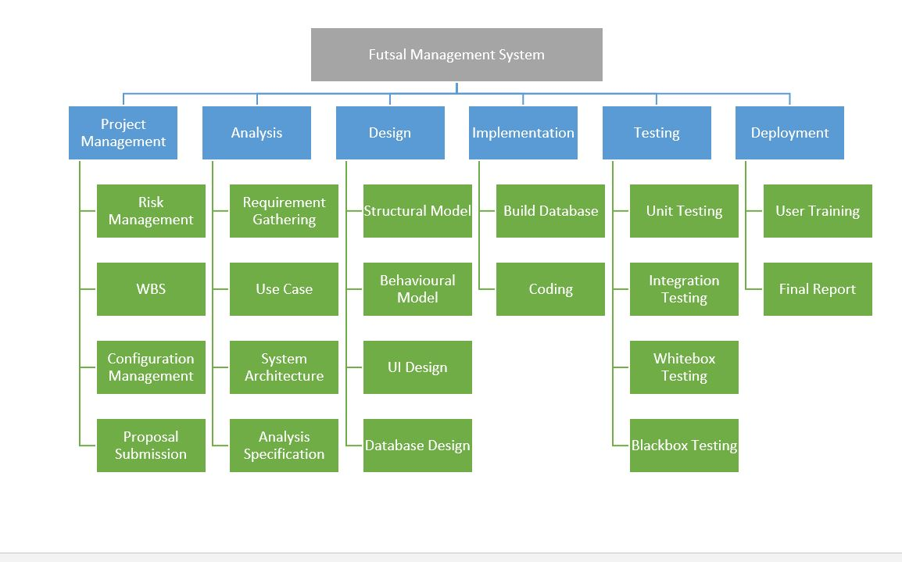
Work Breakdown Structure

Slide 10
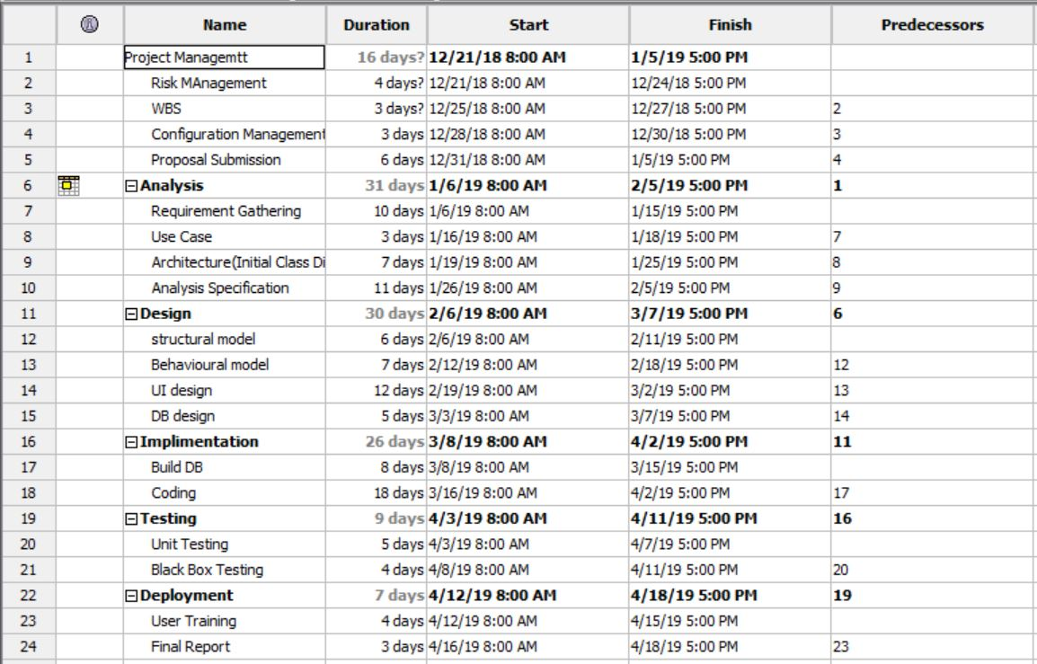
Gantt Chart-1

Slide 11
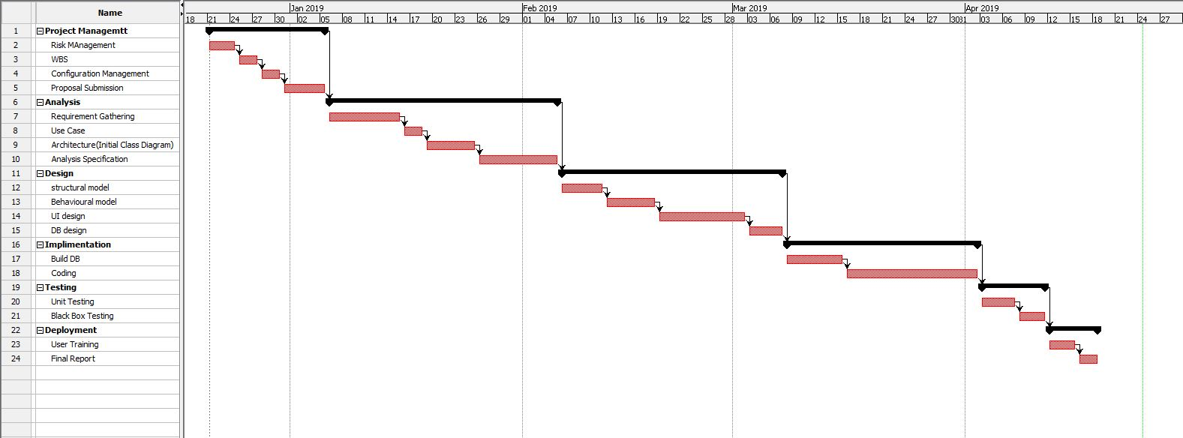
Gantt Chart-2

Slide 12
Development Methodology
Waterfall Model
Requirement Analysis
Design
Implementation
Testing
Installation
Maintenance

Slide 13
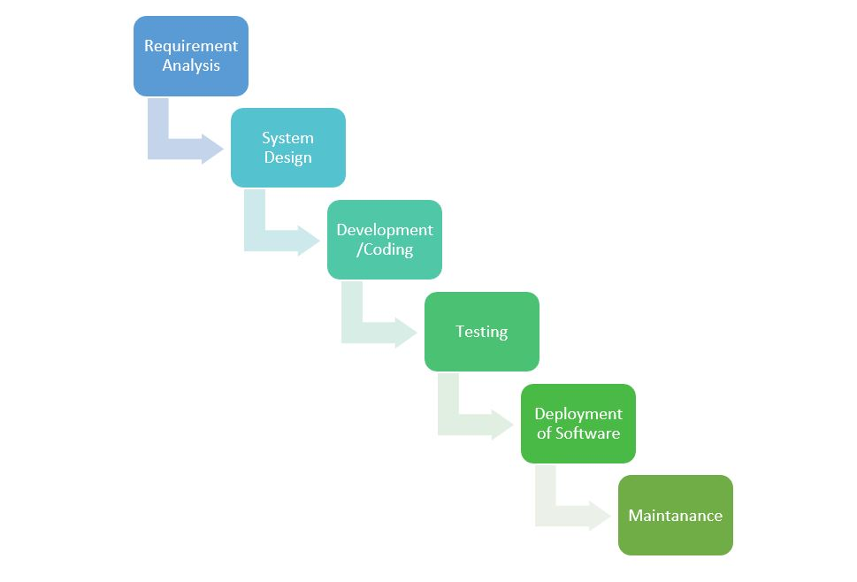
Why Waterfall?
Easy to use, Easy to understand
Stages are well defined and complete
one at a time
Easy to arrange tasks and document.

Slide 14
Design Patterns
MVC- Model View Controller
Model
Central part and UI Independent.
View
Basically, view handles UI design of an application
Controller
It accepts user inputs and translate it as command for Model or View.

Slide 15
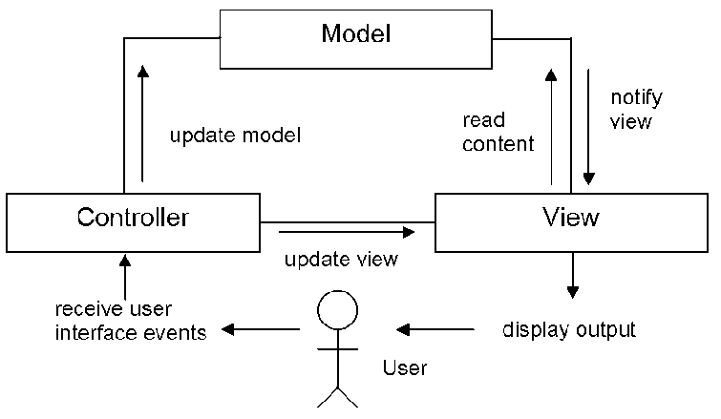
Why MVC ?
Simultaneous development .
Easy Modification.
Multiple views for single model.
Offers high cohesion and low coupling.

Slide 16
Architecture-”3-Tire Architecture”
Presentation layer
Displays view of your system i.e. UI. It sends contents to browser in form of HTML/CSS/JS.
Application layer
Application server is used and processes business logic for an application.
Data layer
It is simply Database management system, which lets you access over application data.

Slide 17
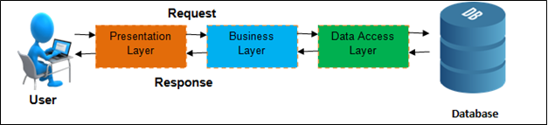
Why 3 Tire Architecture
High performance
Development Flexibility
Improved security
Easy Maintenance
Scalability

Slide 18
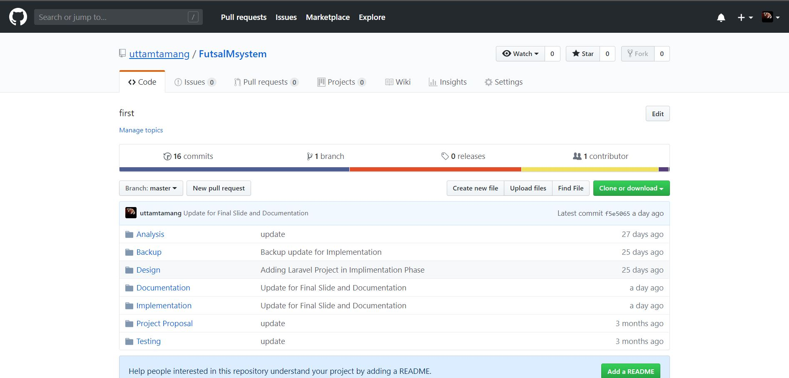
Risk and Configuration Management

Slide 19
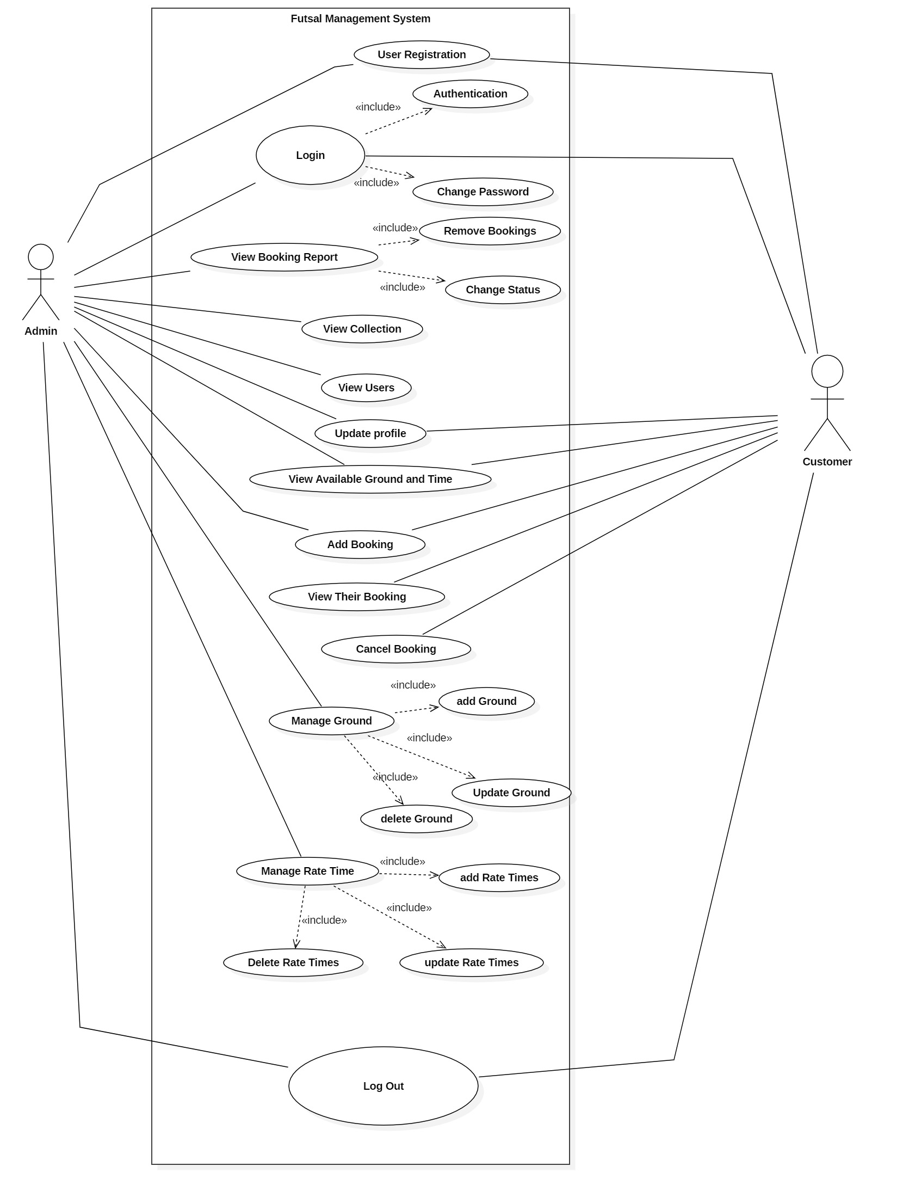
Use Case Diagram

Slide 20
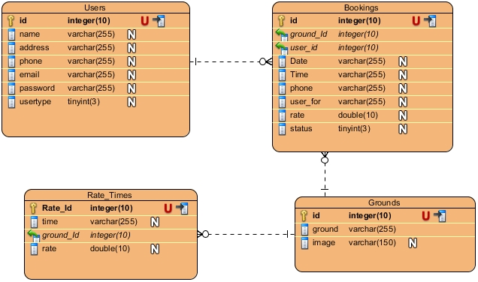
ER-Diagram

Slide 21
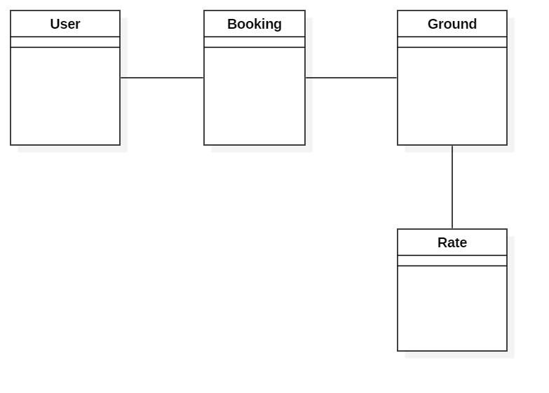
Static System Architecture – Class Diagram (Initial)

Slide 22
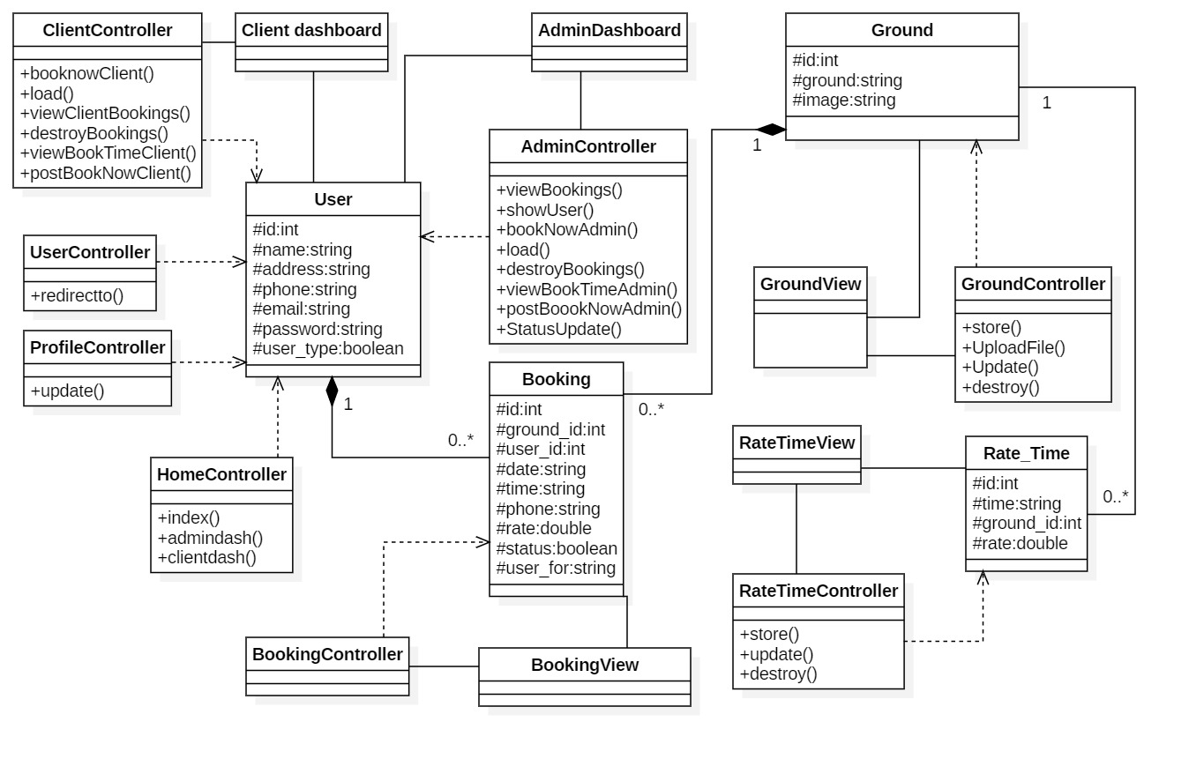
Static System Architecture – Class Diagram Final

Slide 23
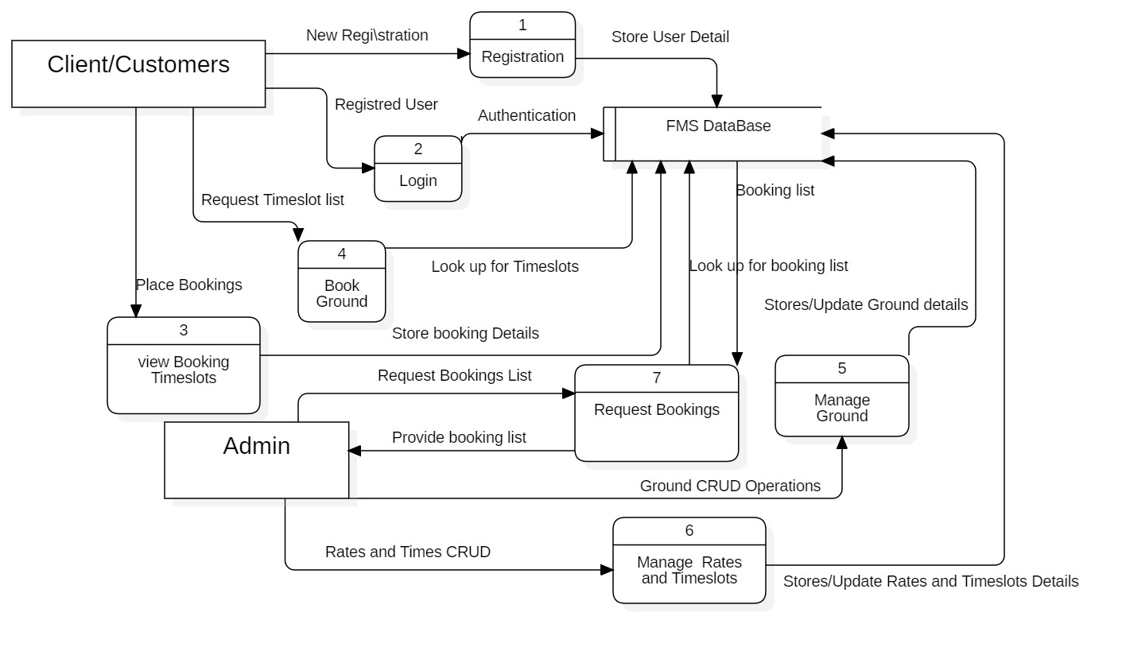
DFD-Data Flow Diagram

Slide 24
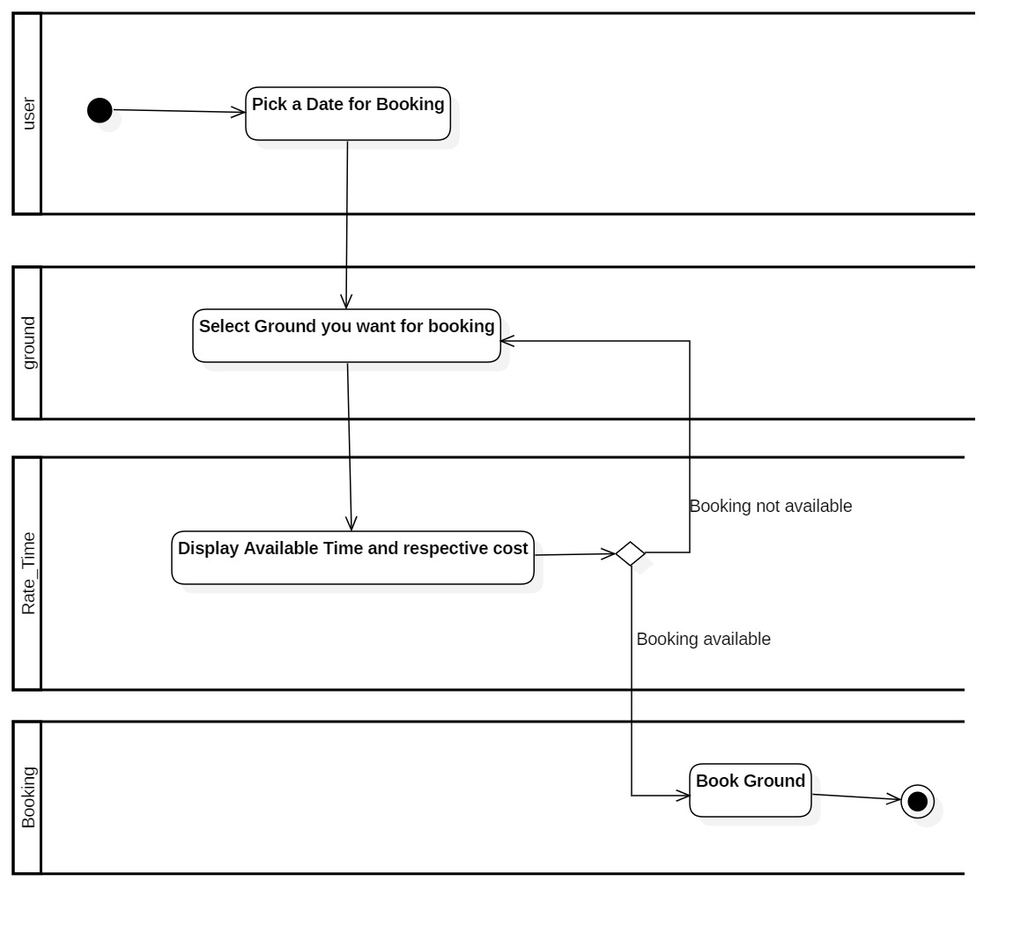
Activity Diagram -1 (Available Timeslot for booking)

Slide 25
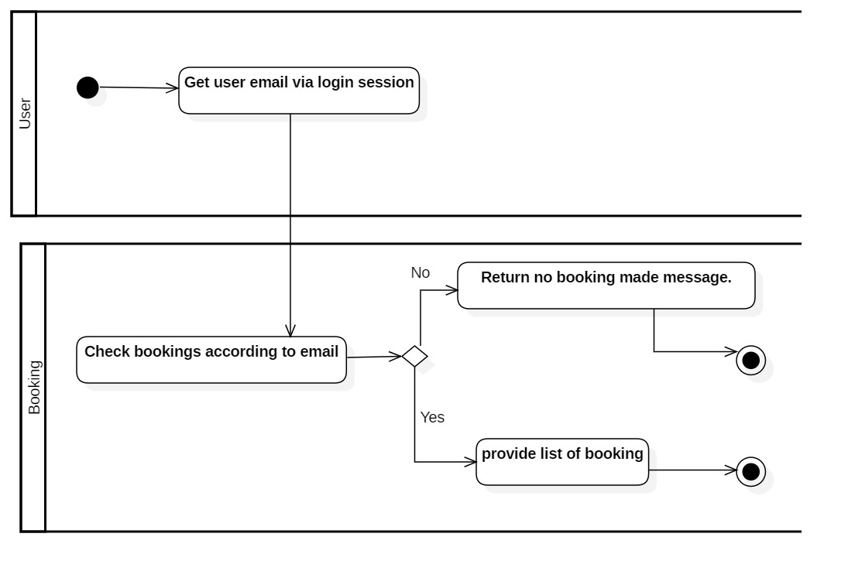
Activity Diagram-2 (View Booking Detail)

Slide 26
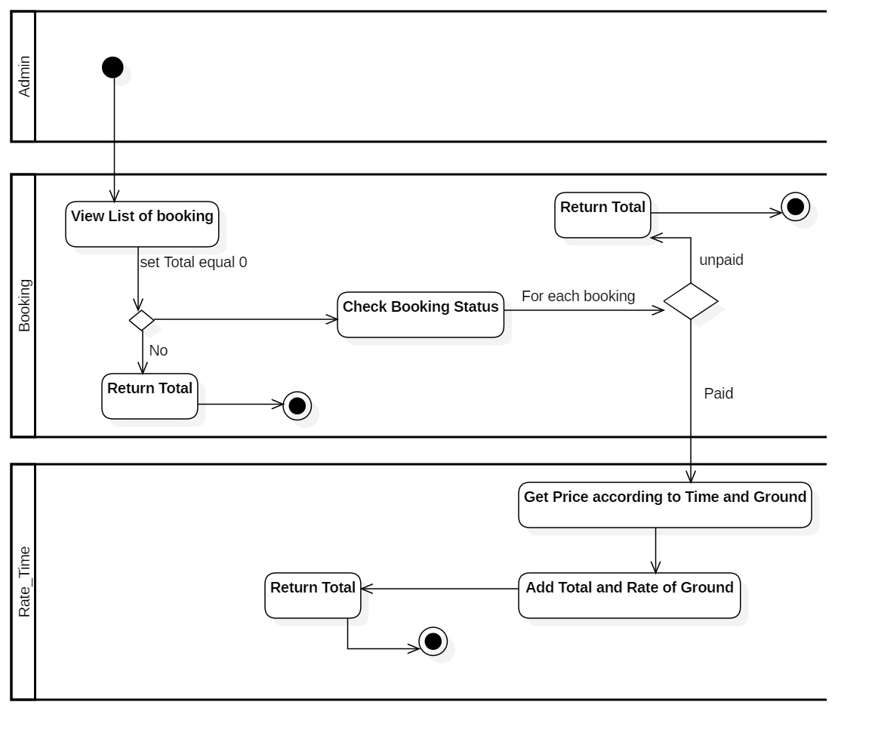
Activity Diagram-3 (Calculating Collection)

Slide 27
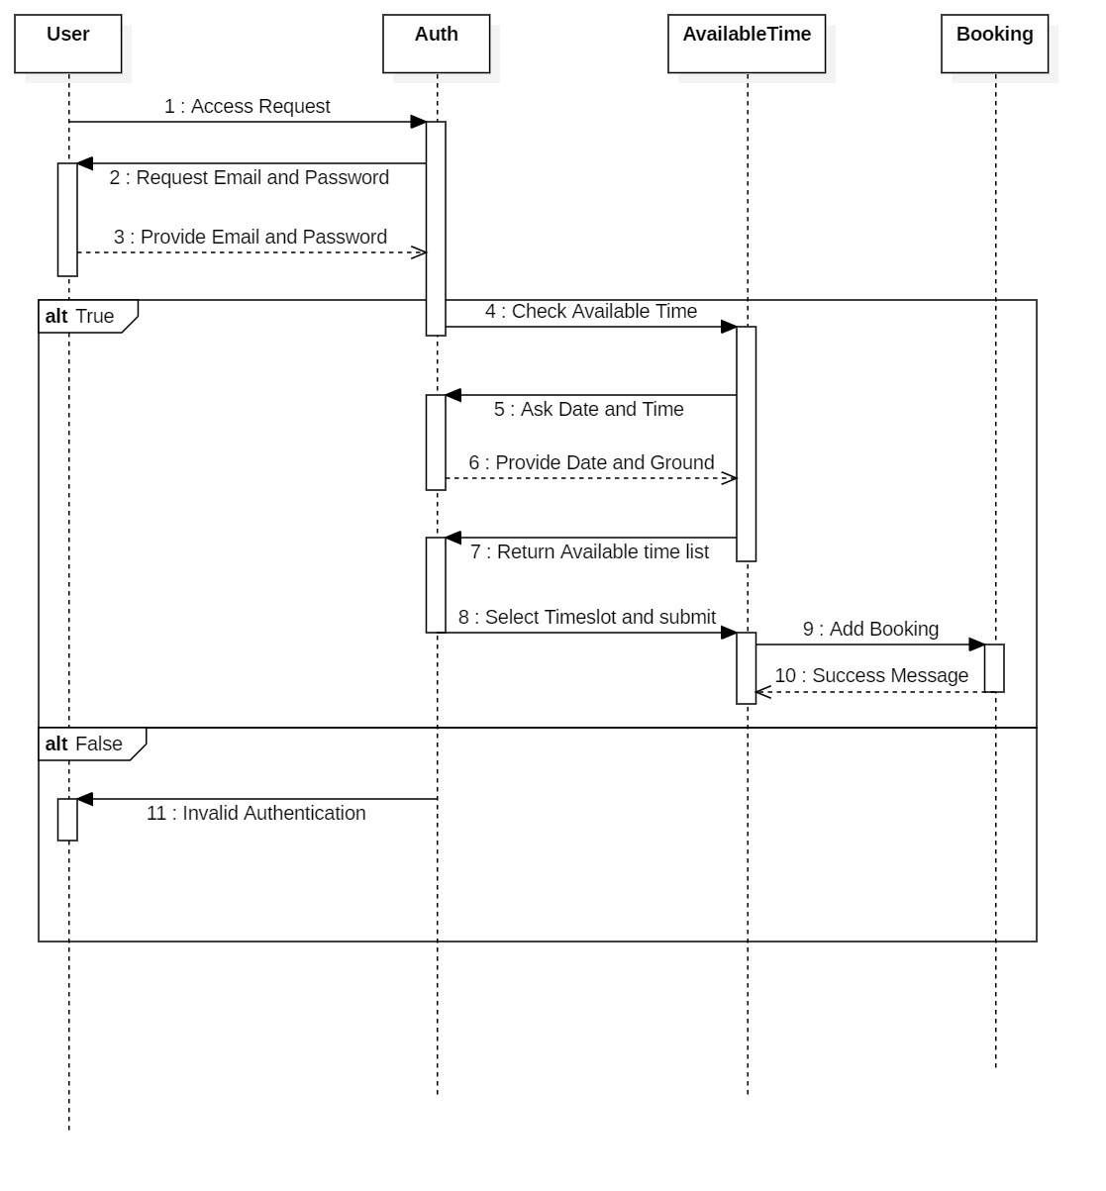
Sequence Diagram 1 (Adding Booking)

Slide 28
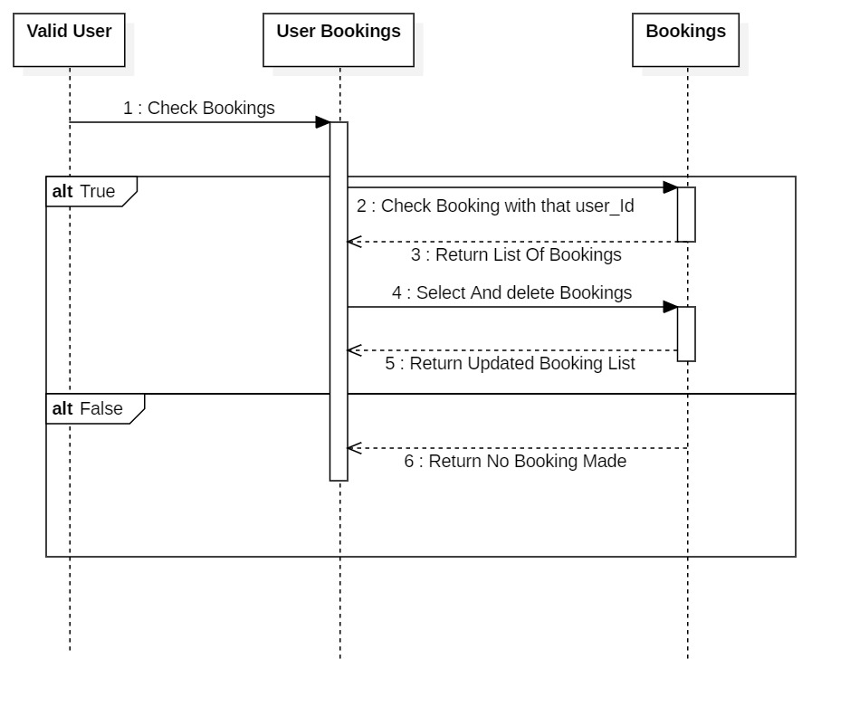
Sequence Diagram 2 (Delete Booking)

Slide 29
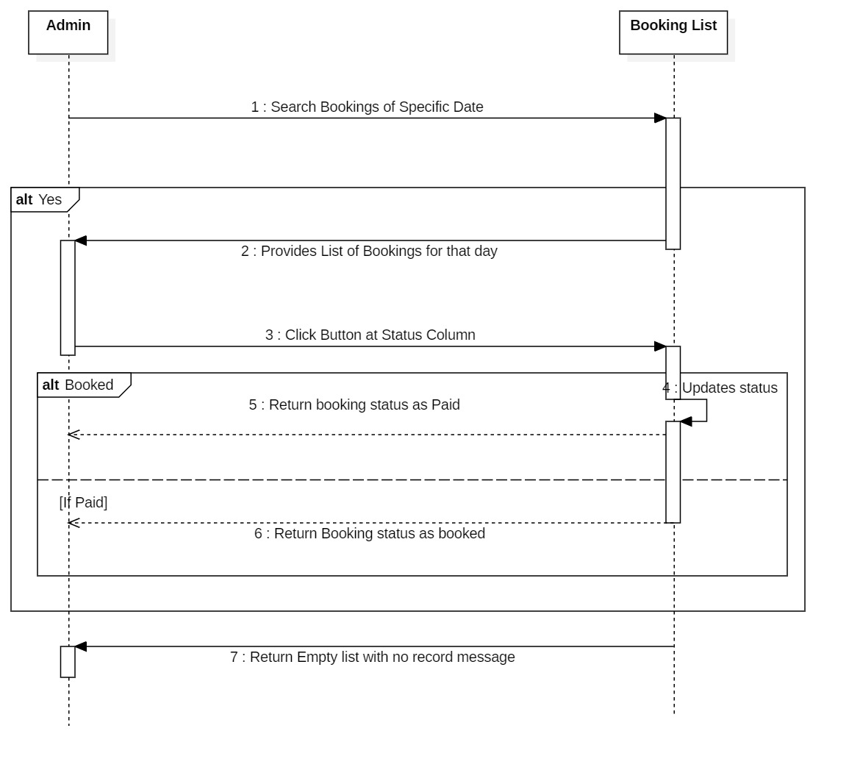
Sequence Diagram-3 (Status Change)

Slide 30
User Interface
3 major pages
Home page of futsal
Admin page
Customer/Client page

Slide 31
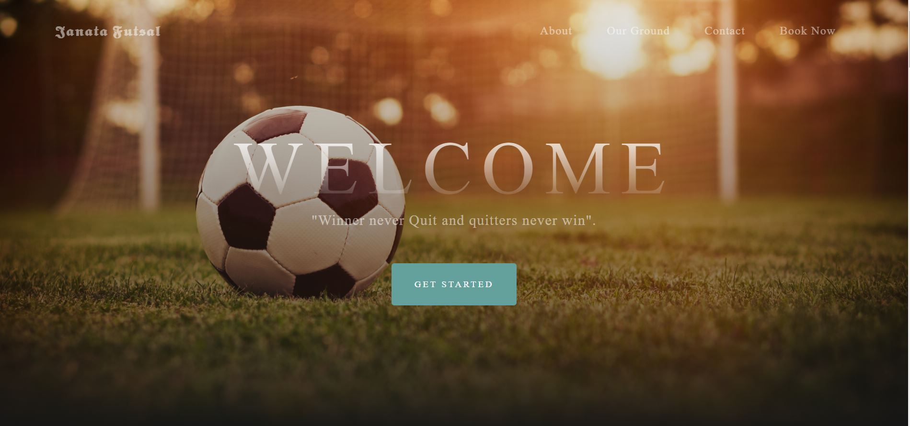
Home Page

Slide 32
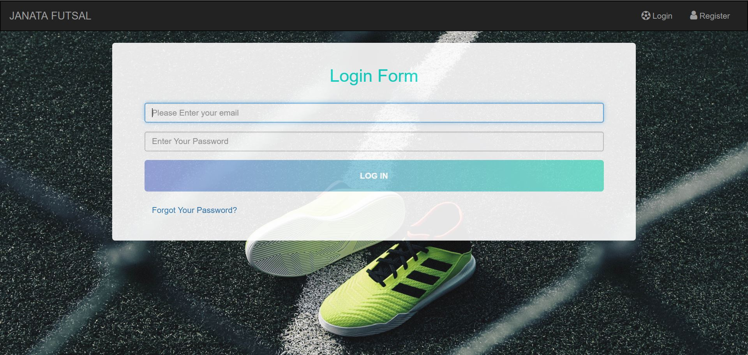
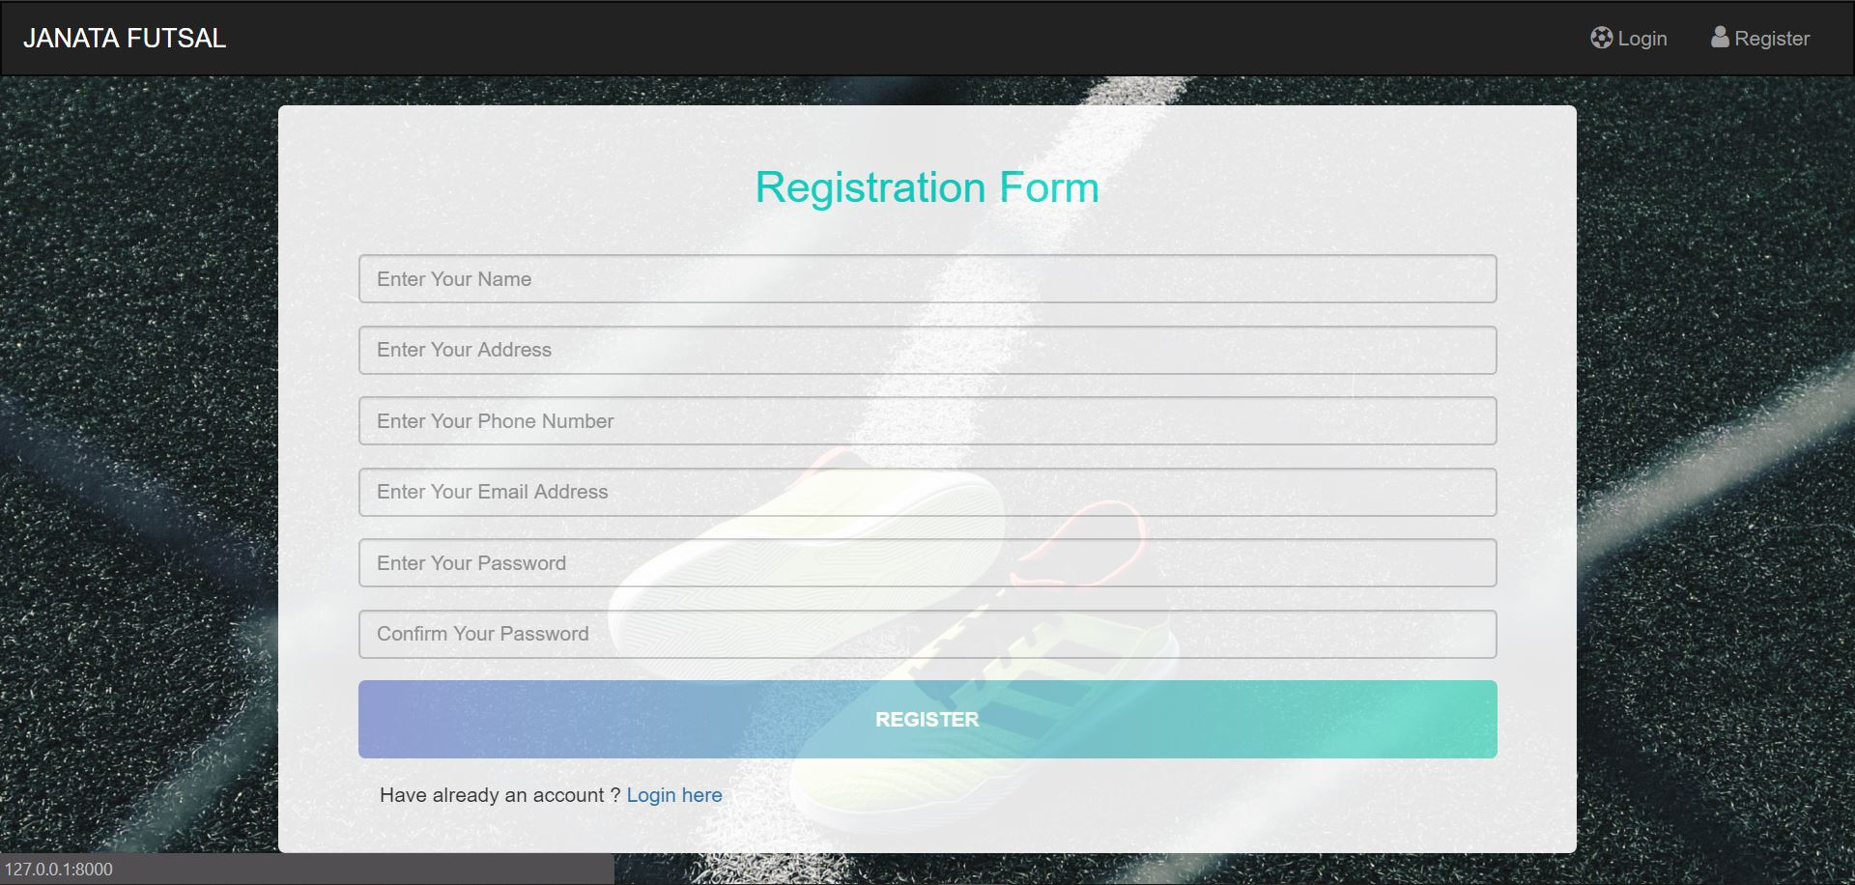
Login and Registration

Slide 33
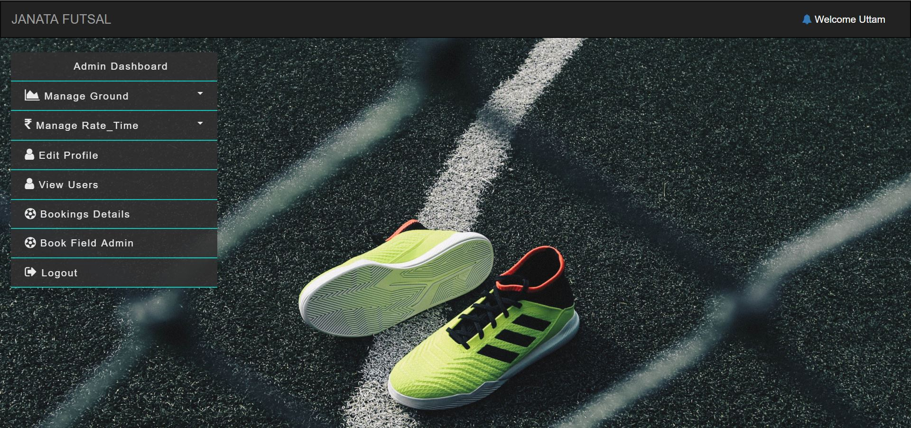
Admin Dashboard

Slide 34
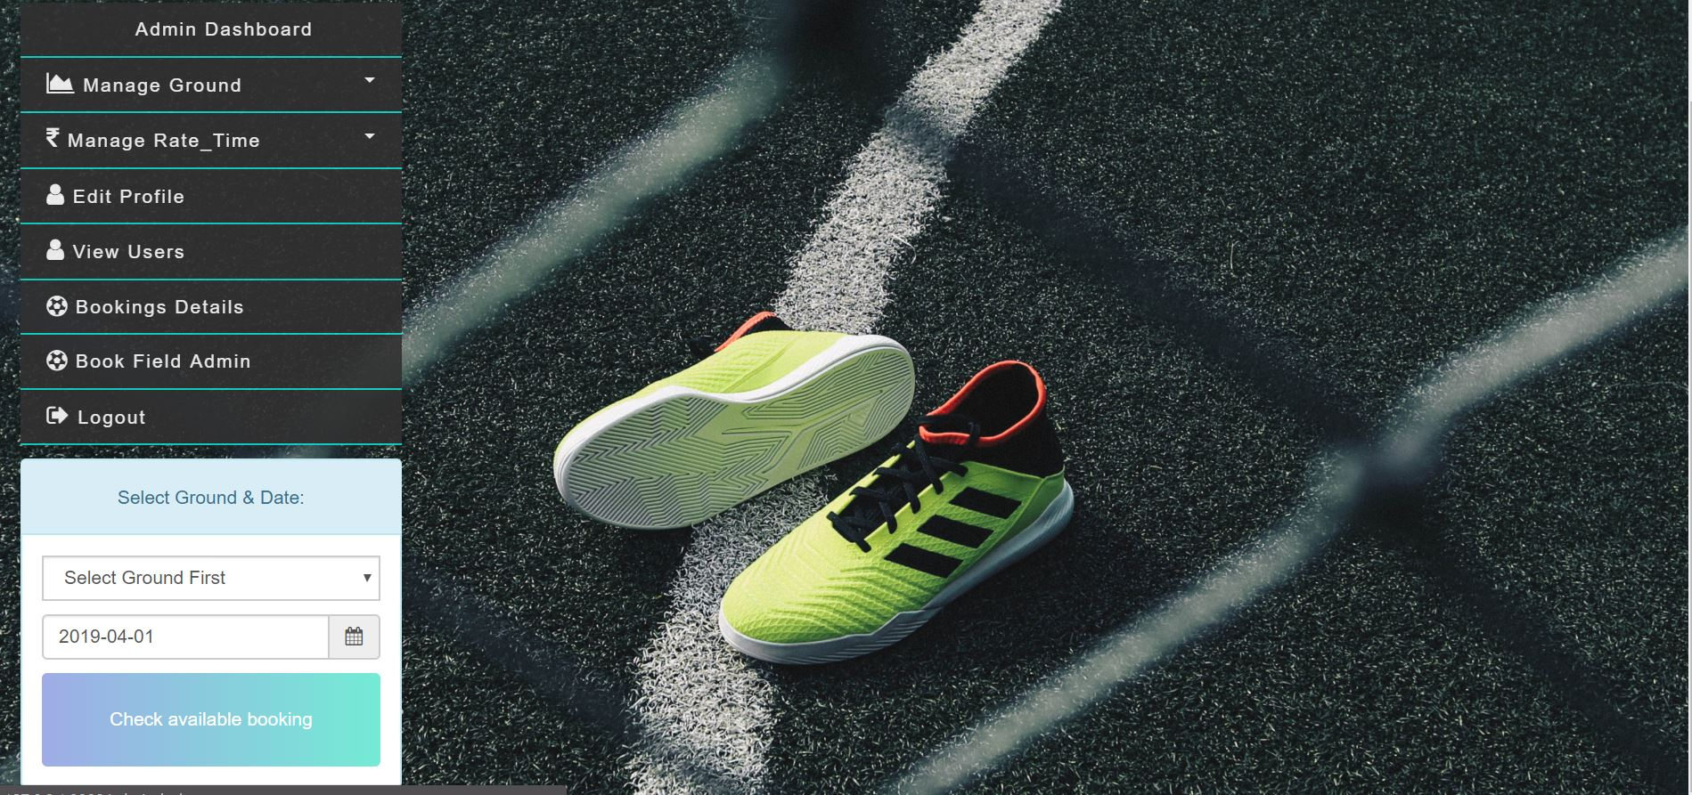
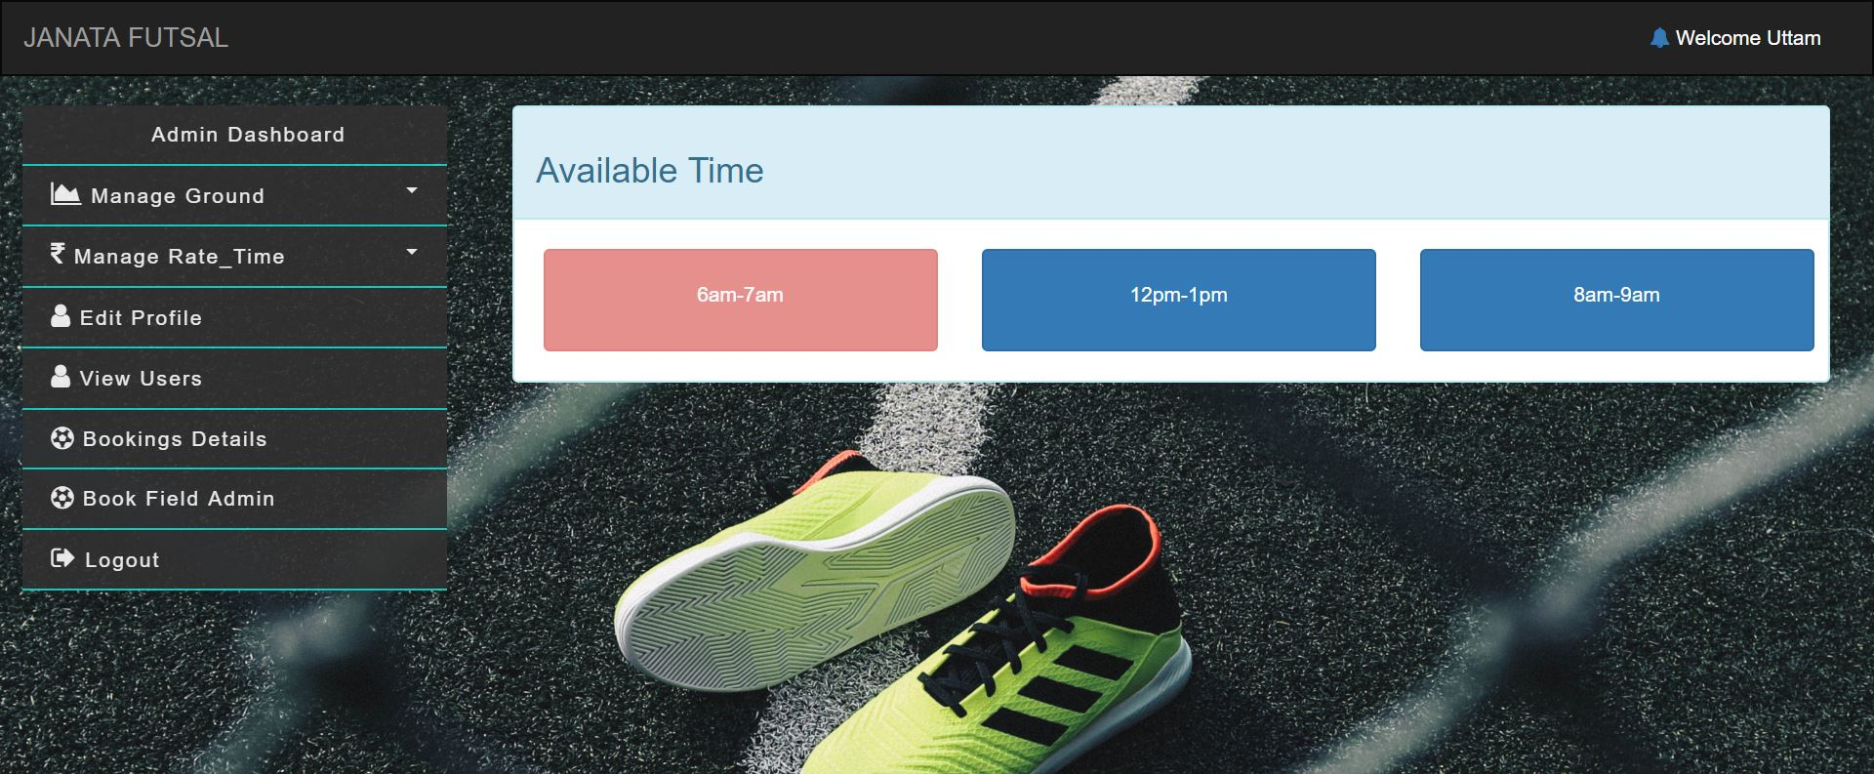
Admin Booking Process

Slide 35
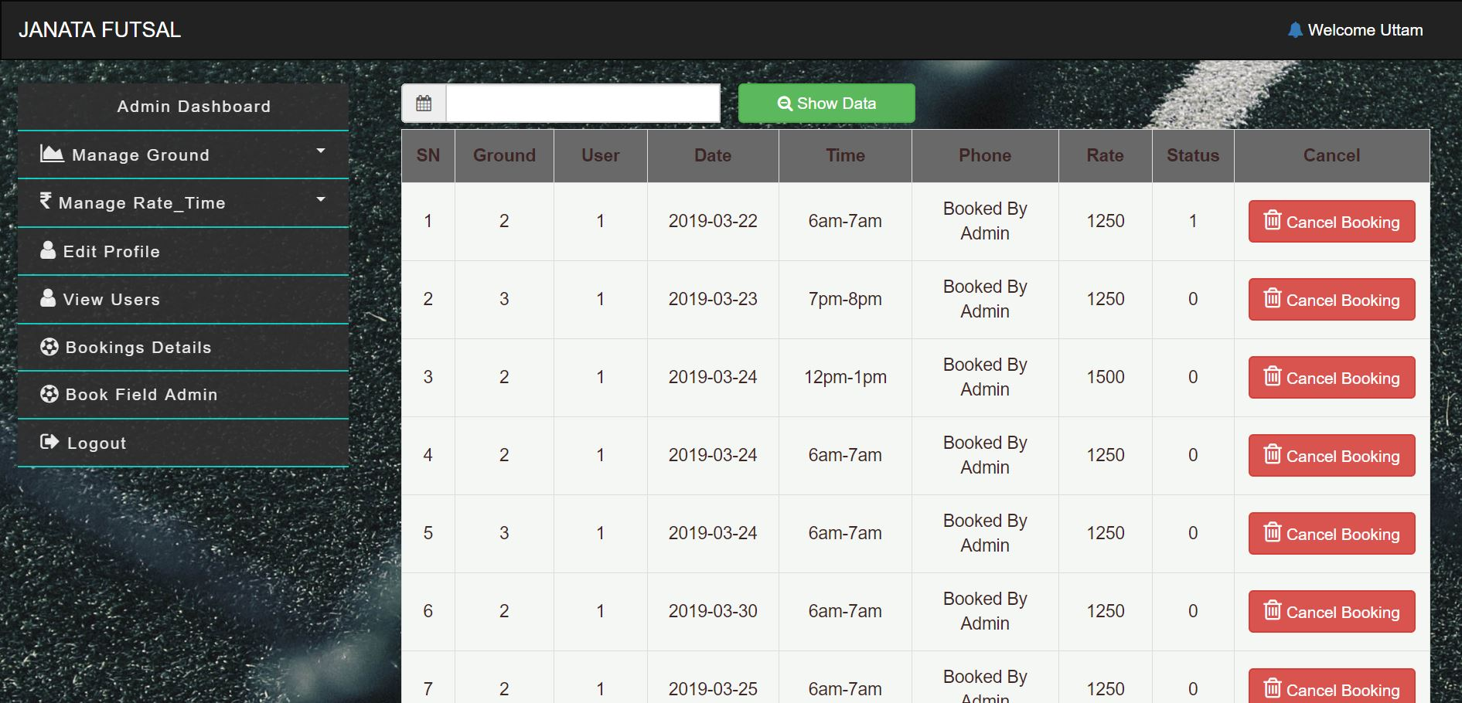
Listing out booking detail for admin.
Initially, Displays All bookings detail
Also, can be sorted with specific time.

Slide 36
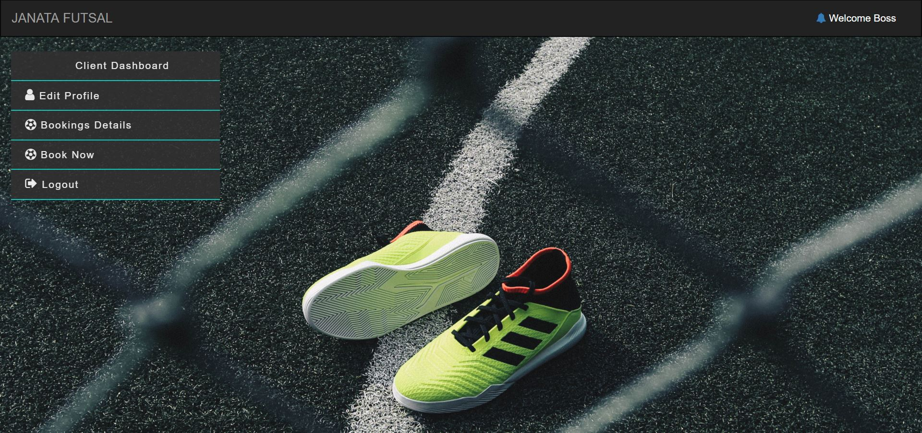
Client Dashboard

Slide 37
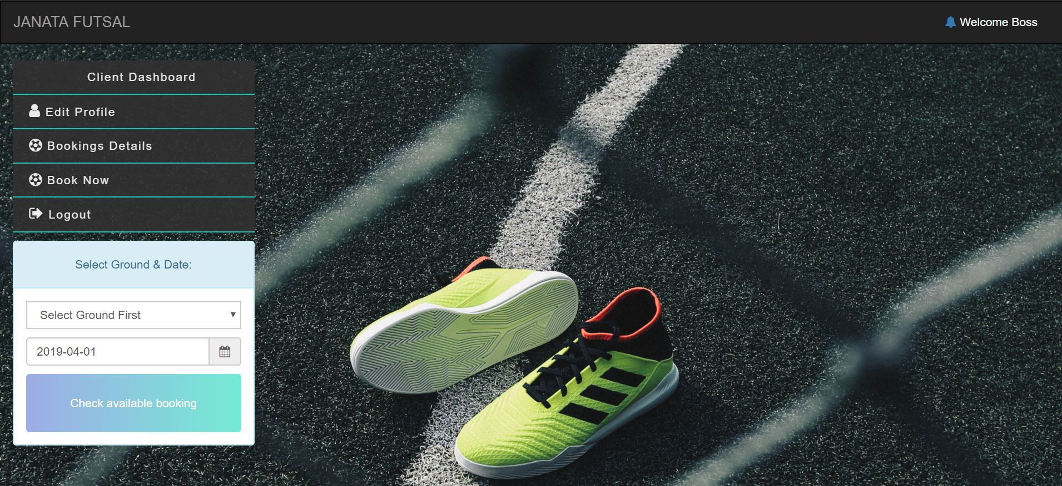
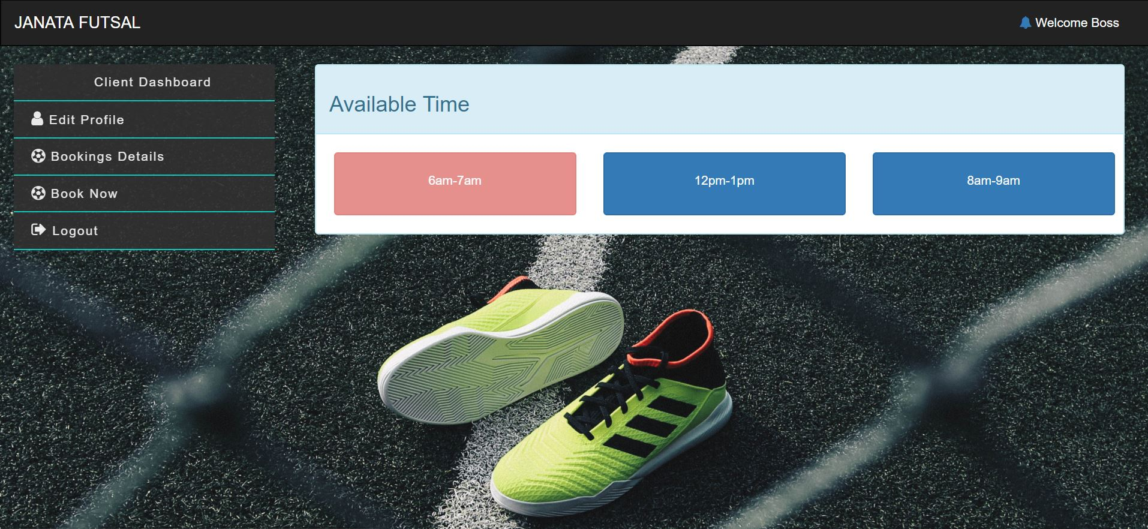
Client Booking

Slide 38
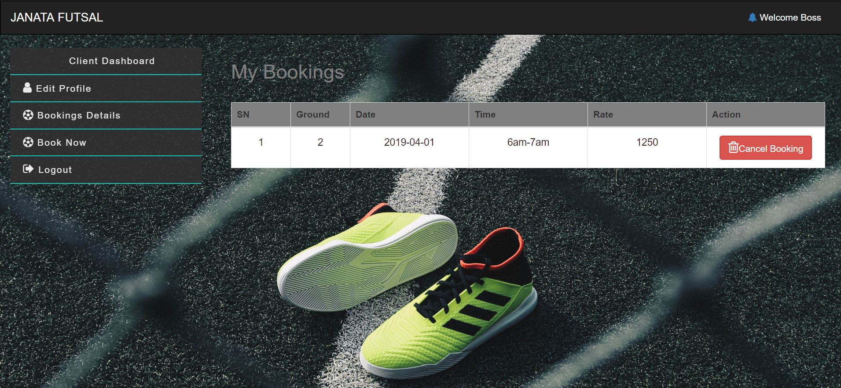
Booking Detail for Client

Slide 39
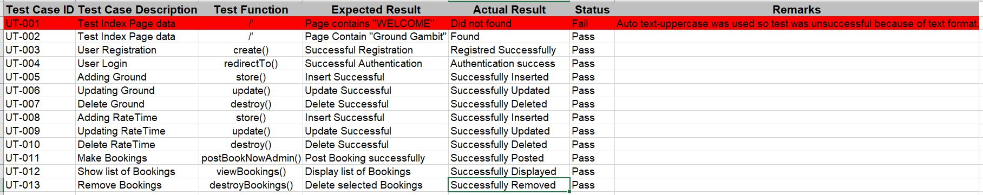
Testing and Test Cases
Black Box Testing - UI testing.
Unit Testing – Functionality Testing

Slide 40
Future Work
Online Payment System and Booking Enhancement
Automation in canceling booking which are not paid in time
Accessibility function
UI/UX enhancements
Online Billing/Originality Testing Feature
Customer Helpline system

Slide 41
Limitations
No Online Payment Gateways.
Billing system is not user appealing.
You can update your profile information but not passwords.
No accessibility features.
Only, for Ground Booking.

Slide 42

User Manual
Home Page
Now, Click “Book Now” for your Booking process.

Slide 43
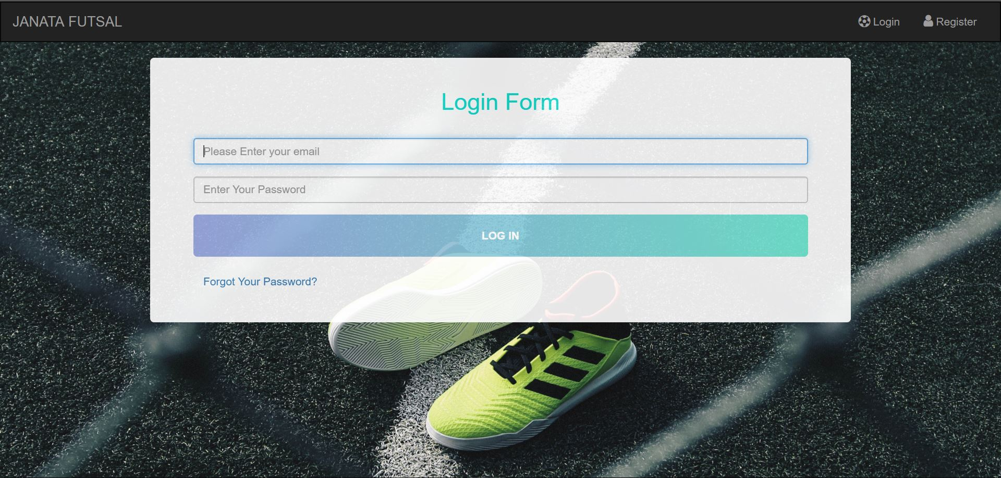
Step 2. Login Page
Now, enter your email and password in order to access our client dashboard.
If you are new here then click on “Register” text which is presented at top right of navigation bar.

Slide 44
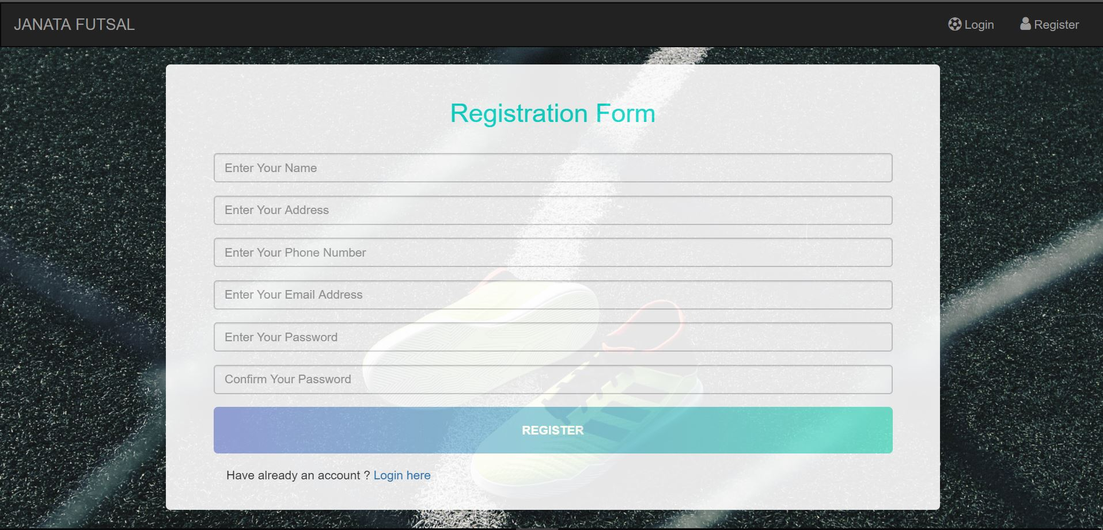
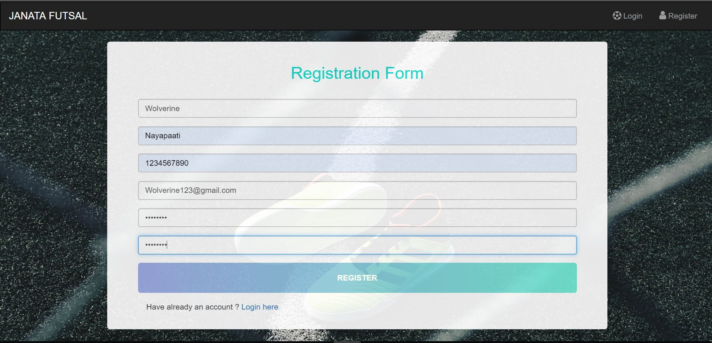
Step 3. Registration Page
This is our registration form of our project.
Fill your information and click “REGISTER” button as in next image.

Slide 45
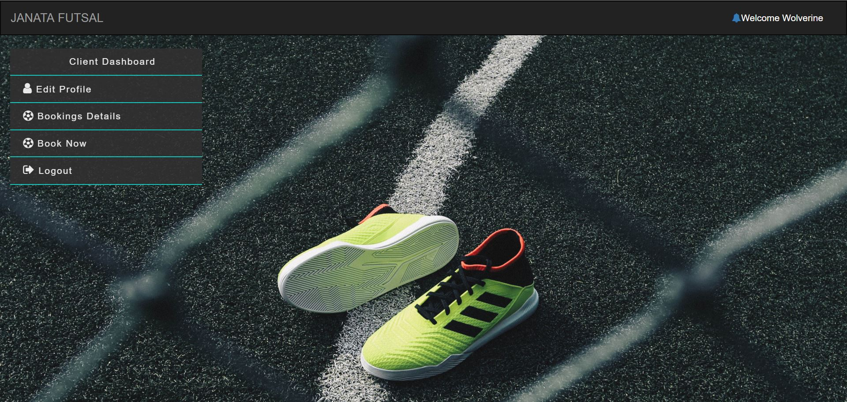
Step 4. Welcome to Your Dashboard
This is your dashboard where you are permit to add your bookings in our ground.

Slide 46
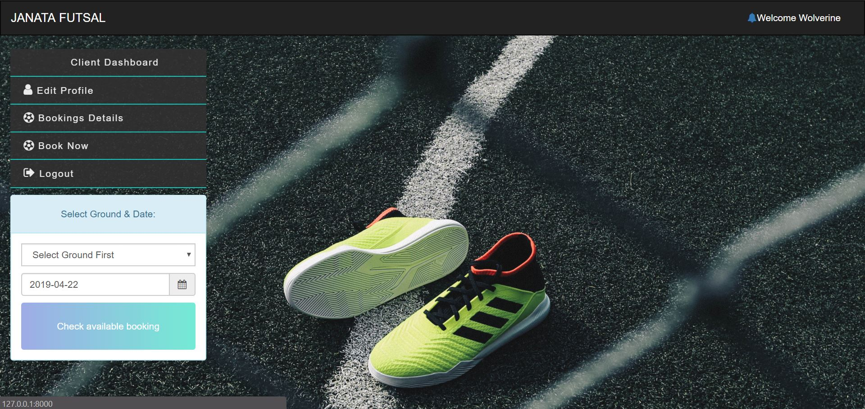
Step 5. Click “Book Now” Button
Select Ground of your choice and date you want for your booking and Search its Available Timeslots.

Slide 47
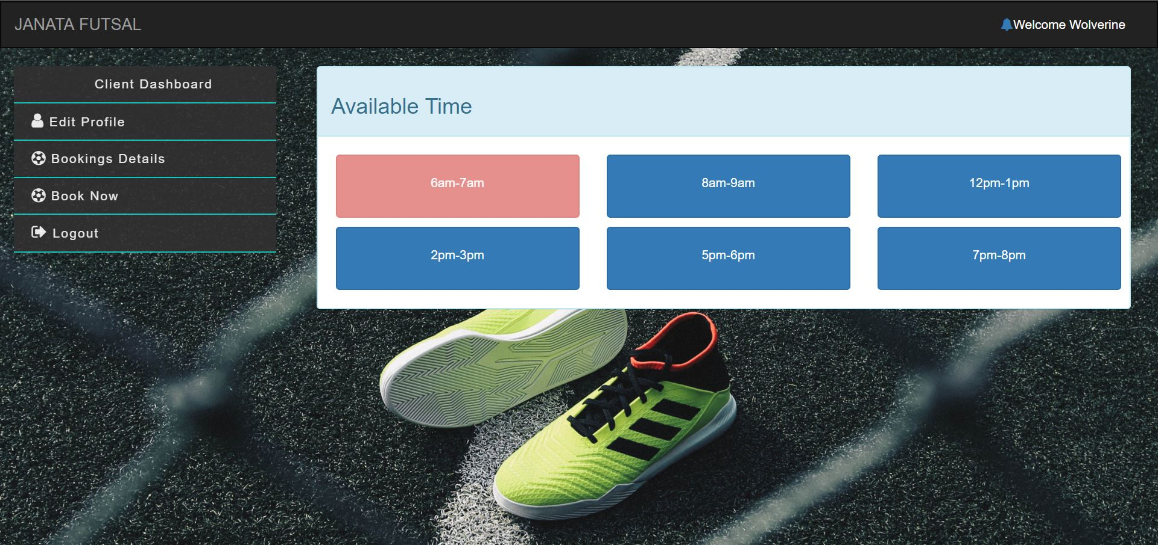
Step 6. List of Timeslots Note: Red button characterized as booked timeslot and blue represent available for bookings.
Select Timeslot of your choice and click on it.

Slide 48
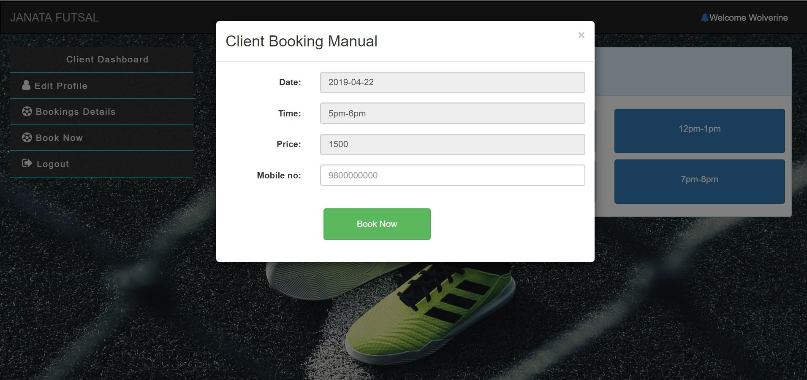
Step 7. Booking Form
Now this booking form will be available as you click your intended timeslot with information about date, time. Price and asking your contact number.
Enter your contact number and click Book Now.

Slide 49
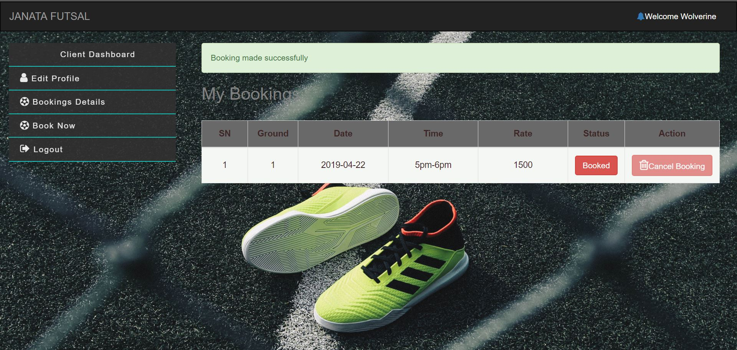
Step 8. Booking list Note: If your booking date and you haven’t paid your booking cost then it will restrict from deleting your bookings and payment status as Booked.
Now, as you booked you will be redirected to your booking detail page with success where you can look, manage your bookings.

Slide 50
Conclusions
Project that I had completed will help with booking automation for futsal organization in a secure and reliable way.

Slide 51
Any Question?

Slide 52
Thank You

